Slide 1
Informatics in Forensic Science

Slide 2
Forensic Databases
Forensic Databases have been known for years in linking and solving crimes
Fingerprint databases are among most well known, however, handwriting, firearms, cartridge cases, bullets, DNA and paint are among other databases available for law enforcement use

Slide 3
Image Databases
Types of image databases:
Fingerprints
Handwriting
Cartridge cases
Commercial Systems
Toolmarks
Shoeprints
Drugs and tablets

Slide 4
Fingerprints
Four major approaches of search –
Syntactic – ridge pattern and minutiae are approximated by a string of primitives
Structural – features based on minutiae are extracted then represented using a graph data structure. Use of topology does the matching

Slide 5
Fingerprints
Neural networks – a feature vector is constructed and classified by a neural network classifier
Statistical classifier approach – statistical classifiers are used instead of neural network classifiers

Slide 6
Handwriting
Fish System – oldest system developed by Bundes Kriminalamt (BKA) of Germany
Script system – developed by TNO of Netherlands
In both systems, handwriting is digitized and strokes of certain letters are analyzed with user interaction
Interline and interword distance are measured in the script system

Slide 7
Handwriting
Fish system analyzes black and white statistics and upper and lower loops of letters
Systems are used to analyze threatening letters

Slide 8
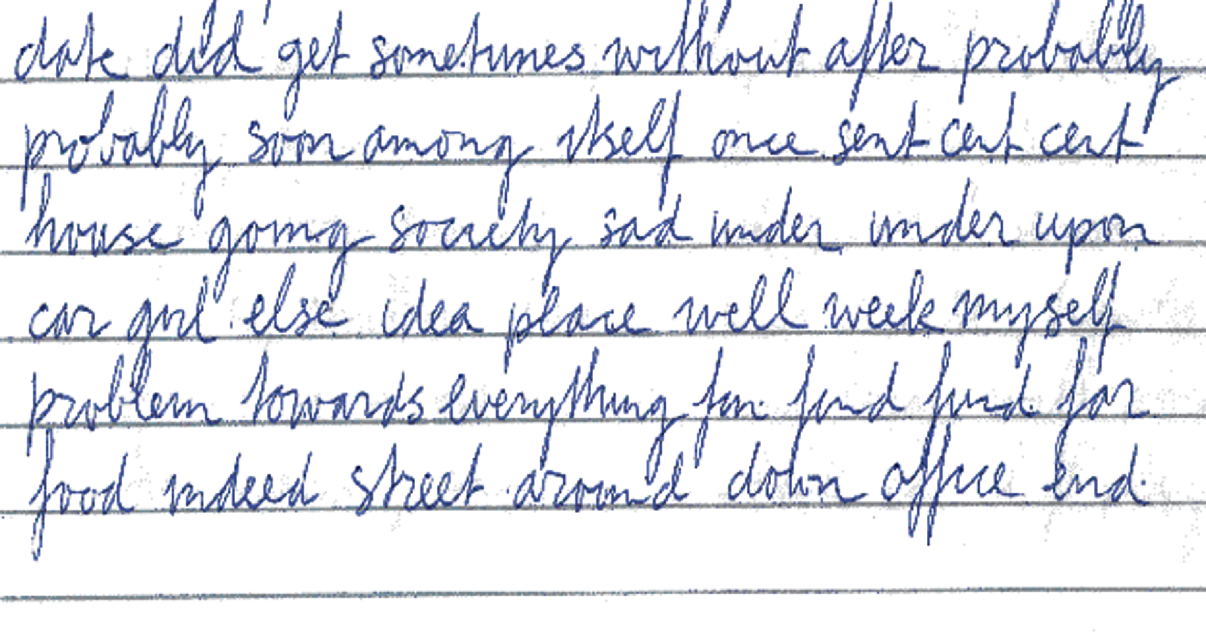

Slide 9
Cartridge Cases
When a firearm is loaded and fired, mechanisms and parts in the firearm that come into contact with cartridge leave impressions and striations
Netherlands Forensic Science Institute marks and striations on cartridges and cases are compared with test fired bullets

Slide 10
Cartridge Cases
Commercial systems of databases for acquiring, storing, and analyzing images of bullet and cartridge cases include:
DRUGFIRE
IBIS – Integrated Ballistics Information System
IBIS is replacing DRUGFIRE and will be standard system in United States

Slide 11
Cartridge Cases
Both DRUGFIRE and IBIS capture images of striations and markings left on cartridge cases
Electronic signature is produced from these images
Hit lists are used which allows for the order of most relevant images to the user displayed one

Slide 12
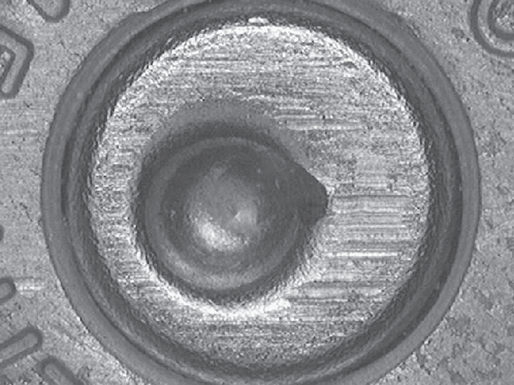
Cartridge casing with breech face and firing pin marks

Slide 13
Toolmarks
Tools can be determined to be instrument used based on impressions or striation marks left on object
Characteristics allow comparison of tool mark impressions from scene with impression made by tool
Striation marks are analyzed by signature of striation mark itself and comparison

Slide 14
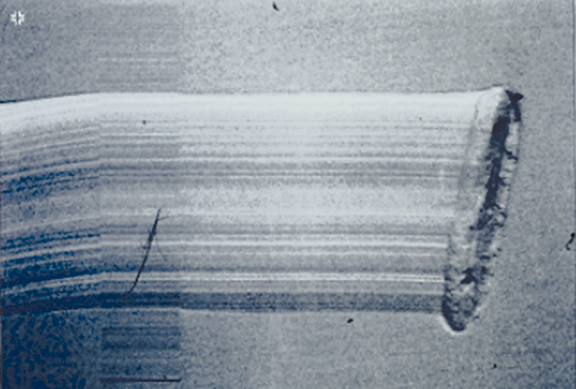
Striation mark of a screwdriver

Slide 15
Shoeprints
Several databases are available concerning shoeprints:
Database of shoeprints found at crime scene
Database of shoes of suspects
Database of shoes on market

Slide 16
Shoeprints
Classification is divided into class and subclass
Shapes, such as circles, triangles, etc on shoeprints are divided and can be separately analyzed
Shape recognition is done with a neural network

Slide 17
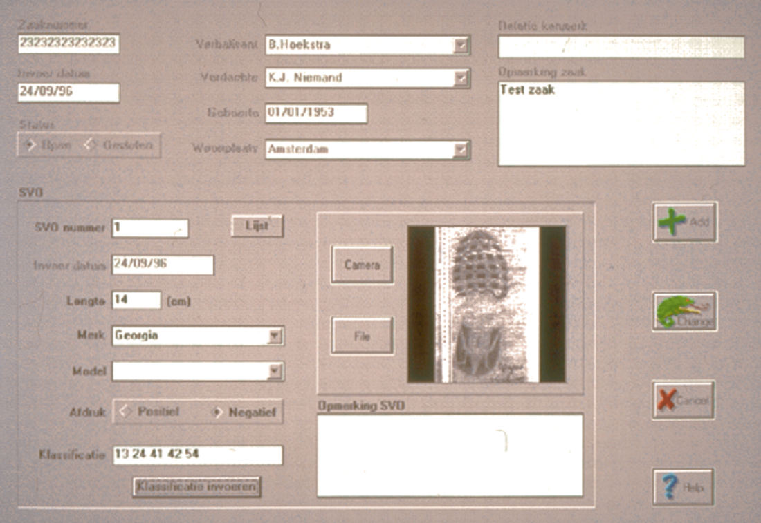

Slide 18
Database of Drug Tablets
Database and manuals are available with images of all manufactured drugs
Images of tablets are available, however, certain problems can occur
Two images of pill may vary due to light at time of photography
Logo of tablet may not be clearly visible

Slide 19
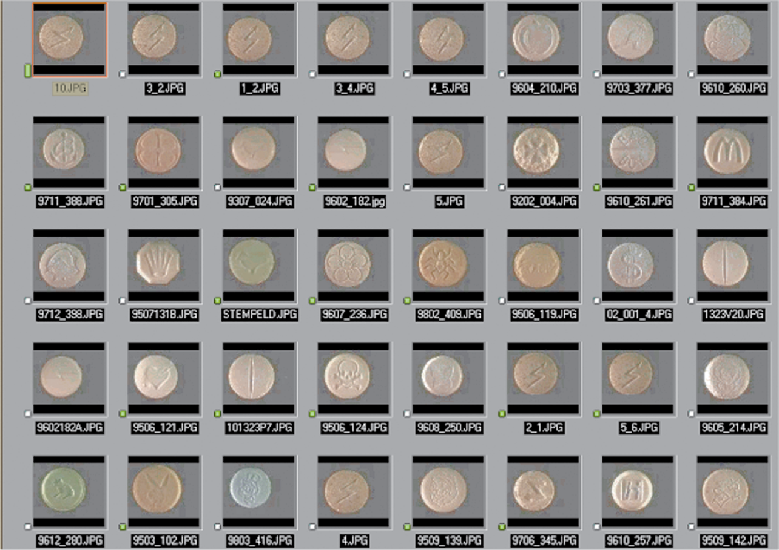

Slide 20
DNA Databases
Most countries have started databases for solving burglaries and other crimes
Combined DNA Identification System (CODIS) is currently used in the United States
Many countries are developing their own databases

Slide 21
Paint Databases
Paint databases of cars can determine brand and model of car by accident
Database of Bundeskriminalamt in Germany is largest known collection of car paints
Database is shared among countries

Slide 22
Video Image Processing and Animation Software
Surveillance systems can record crime on tape
Tape can become evidence for court
There are several factors associated with video image processing

Slide 23
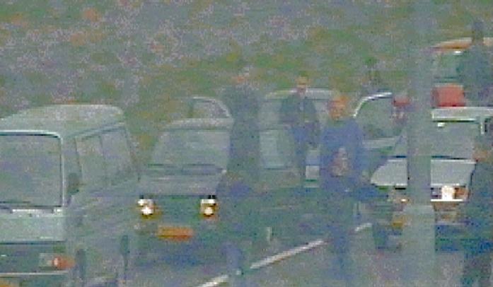

Slide 24
Video Image Processing
Factors involved include:
Image enhancement
Visualization of images for courts
Image comparison
Videotape Integrity
Camera Identification

Slide 25
Three-Dimensional Reconstruction
Can be achieved by bringing suspect to scene of crime and using same video recording system to record person
Photogrammetry involves measurement of parts of scene and suspect and comparison

Slide 26
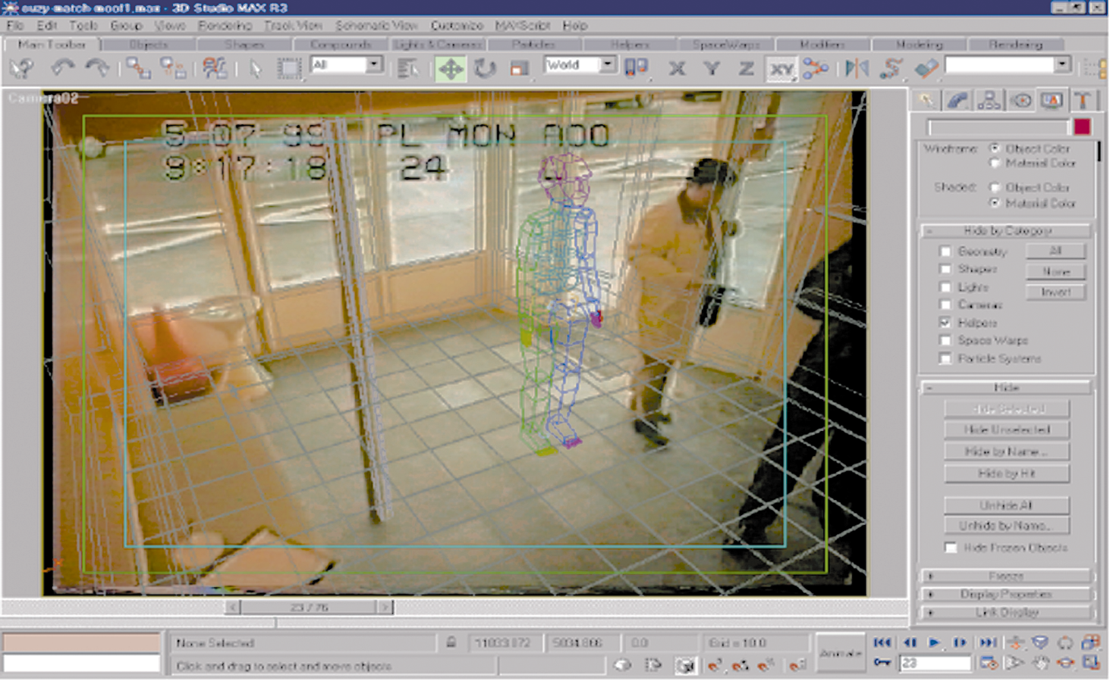

Slide 27
Output to Court
Courts may ask for and receive video output in a variety of ways:
Videotapes
CD-Roms
DVDs
Signatures or hash codes should be used to reflect integrity

Slide 28
Image Integrity
Images can be manipulated
Analog videotapes should be checked for signals
Strong evidence can be gained with documentation of pixel defects in certain cameras

Slide 29
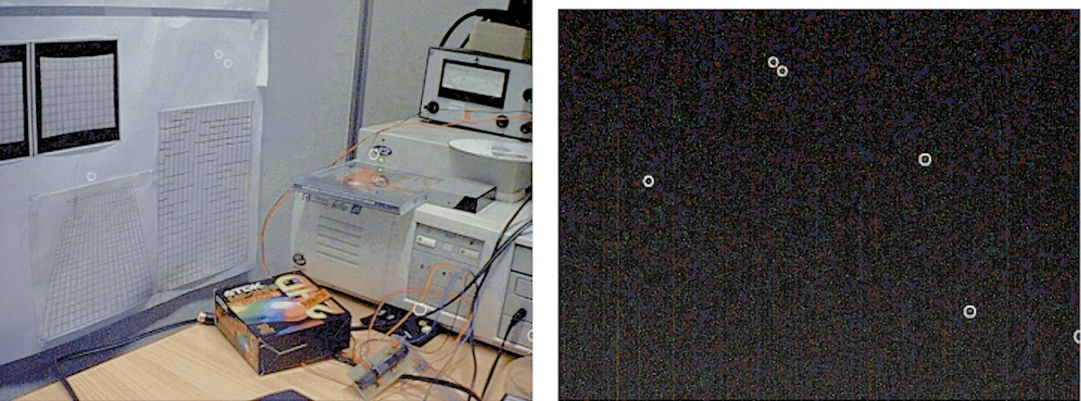

Slide 30
Image Integrity
Forensic examiner should be able to inform the court of the possibilities, limitations and artifacts that might arise from image processing

Slide 31
Literature Databases
Medline- forensic medicine database
STN – over 200 literature databases
CAS – chemical abstracts
Inspec and Compendex – engineering and technology

Slide 32
Literature Databases
DIALOG – combined database with over nine terabytes of information
DIALOG is most complete online system
Ingenta- world’s largest website for search and delivery of research articles. www. Ingenta.com

Slide 33
Databases of Images and Patterns
Ignitable Liquids Reference Collections (ILRC) is a compilation of reference materials used by forensic analysts to conduct fire debris analysis
Comprehensive set of physical specimens of ignitable liquids and accompanying characterization data used in accordance with ASTM

Slide 34
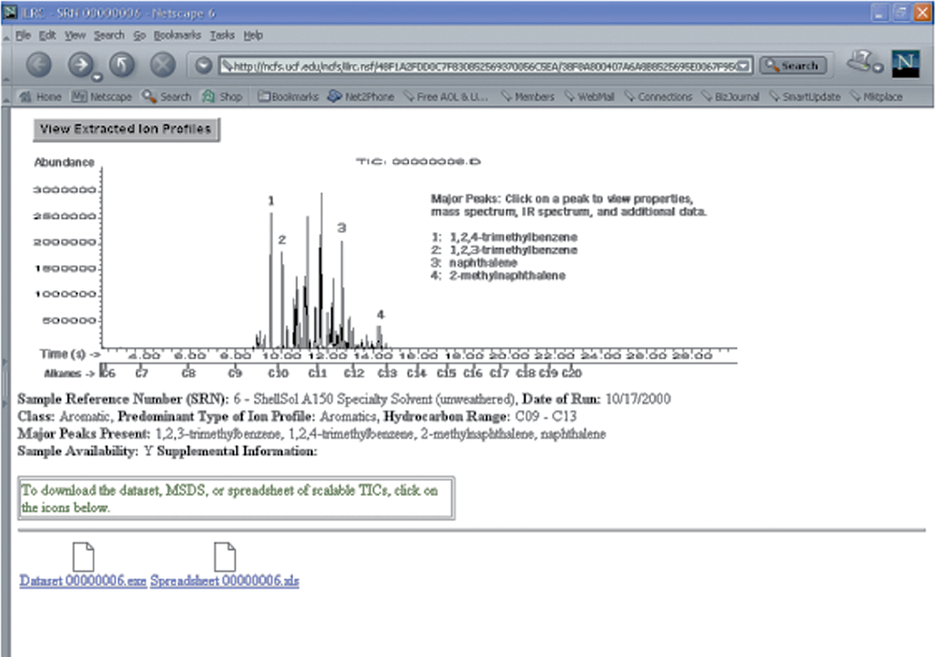

Slide 35
Court Presentation
Use of animation can clarify forensic examination in court
Tools should be acceptable
Specific software may be challenged
EnCase software is de facto standard and usually accepted

